Slide 1
Welcome to
C++ is Fun at Turbine/Warner Bros.!
Russell Hanson

Slide 2
Syllabus
1) First program and introduction to data types and control structures with applications for games learning how to use the programming environment
2) Objects, encapsulation, abstract data types, data protection and scope
3) Basic data structures and how to use them, opening files and performing operations on files
Mini Project 1 Due
4) Algorithms on data structures, algorithms for specific tasks, simple AI and planning type algorithms, game AI algorithms
6) Event-oriented programming, model view controller, map reduce filter
Mini Project 2 Due
7) Basic threads models and some simple databases SQLlite
8) Graphics programming, shaders, textures, 3D models and rotations
7) How to download an API and learn how to use functions in that API, Windows Foundation Classes
8) Designing and implementing a simple game in C++
9) Selected topics - depth controllers like the Microsoft Kinect
Mini Project 3 Due
10) Selected topics
11) Working on student projects
12) Final project presentations

Slide 3
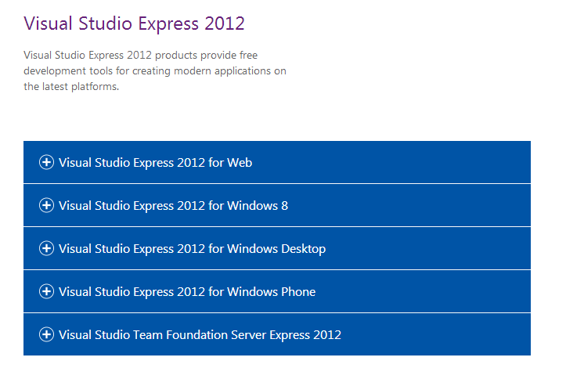
Visual Studio 2012
http://www.microsoft.com/visualstudio/eng/downloads

Slide 4
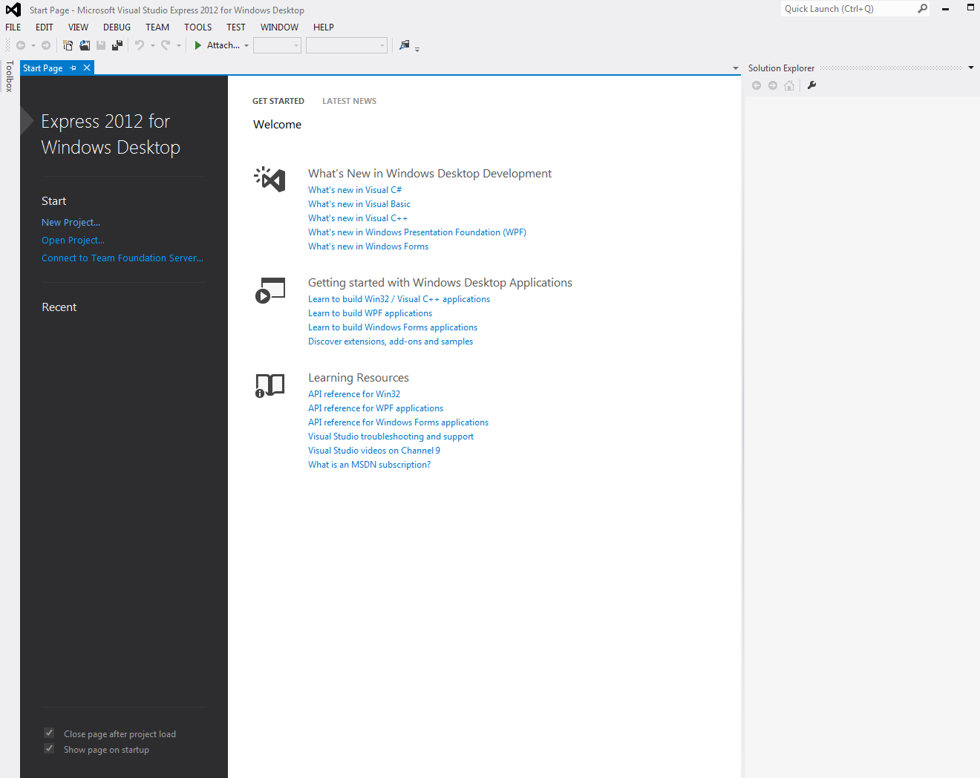

Slide 5
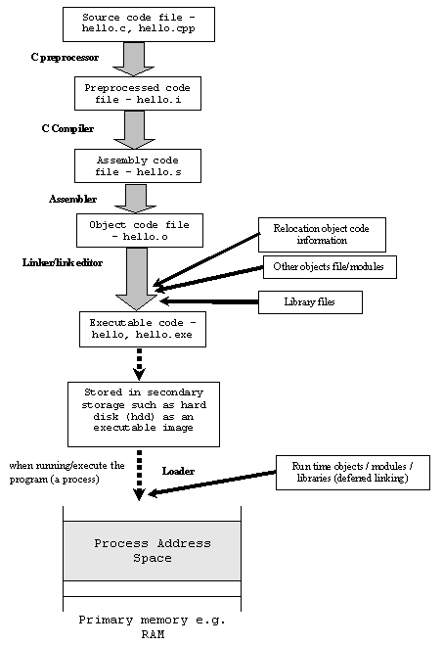
What happens when you write a program?
More reading:
http://www.tenouk.com/ModuleW.html

Slide 6
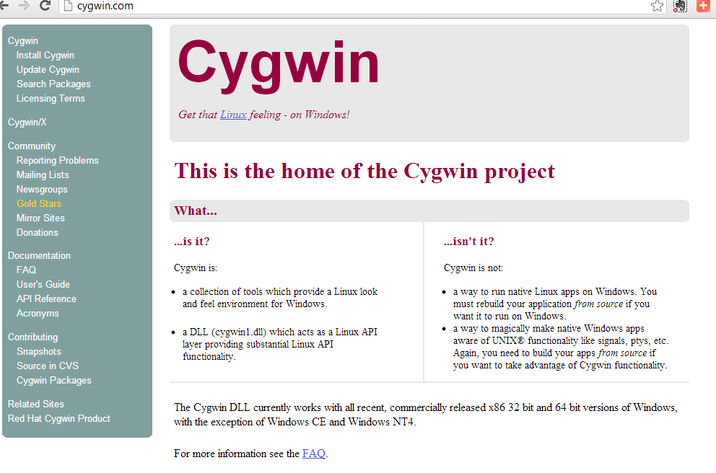
More Linux/Unix style from the command prompt

Slide 7
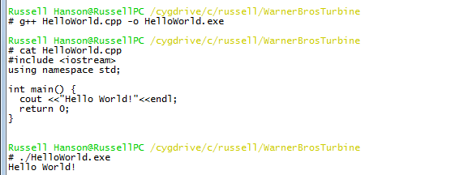
First Program, “Hello World!”
#include <iostream>
using namespace std;
int main() {
cout <<"Hello World!"<<endl;
return 0;
}

Slide 8
#include <stdafx.h>
#include <stdio.h>
static void display(int i, int *ptr);
int main(void)
{
int x = 5;
int *xptr = &x;
printf("In main() program:\n");
printf("x value is %d and is stored at address %p.\n", x, &x);
printf("xptr pointer points to address %p which holds a value of %d.\n", xptr, *xptr);
display(x, xptr);
return 0;
}
void display(int y, int *yptr)
{
char var[7] = "ABCDEF";
printf("In display() function:\n");
printf("y value is %d and is stored at address %p.\n", y, &y);
printf("yptr pointer points to address %p which holds a value of %d.\n", yptr, *yptr);
}

Slide 9
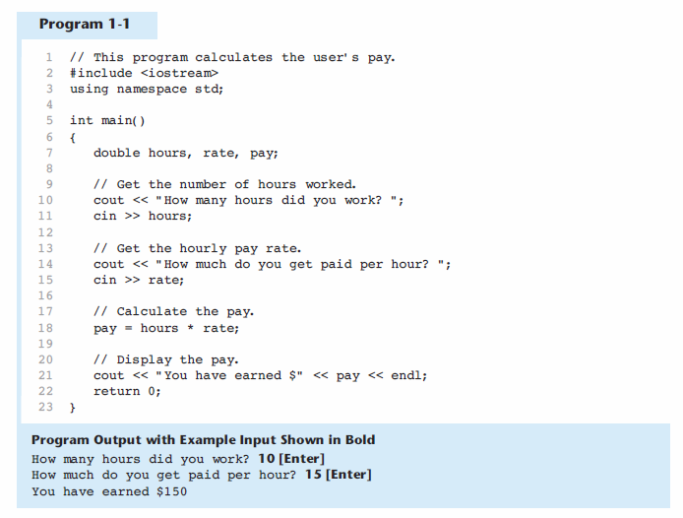

Slide 10
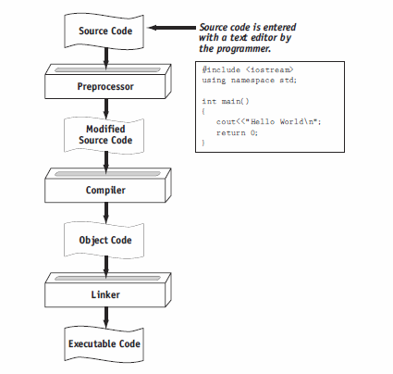

Slide 11
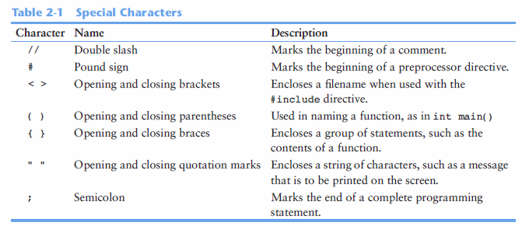

Slide 12
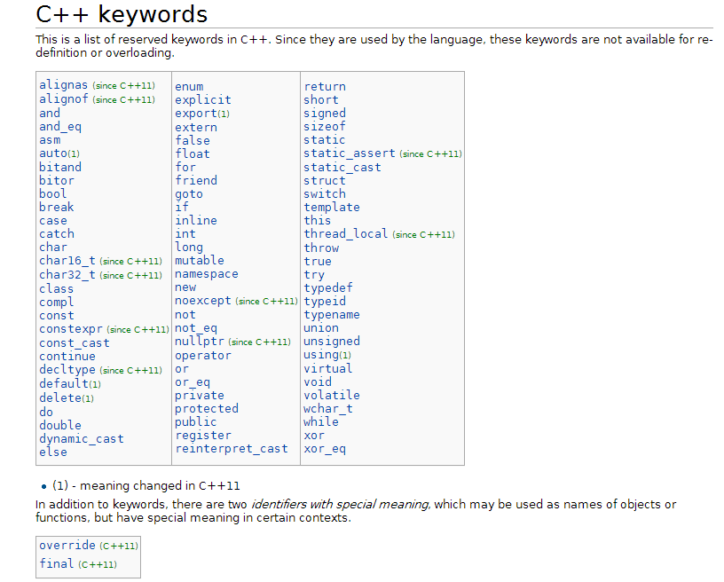

Slide 13
Operators in C++ and operator precedence
Level | Operator | Description | Grouping
1 | :: | scope | Left-to-right
2 | () [] . -> ++ -- dynamic_cast static_cast reinterpret_cast const_cast typeid | postfix | Left-to-right
3 | ++ -- ~ ! sizeof new delete | unary (prefix) | Right-to-left
 | * & | indirection and reference (pointers)
 | + - | unary sign operator
4 | (type) | type casting | Right-to-left
5 | .* ->* | pointer-to-member | Left-to-right
6 | * / % | multiplicative | Left-to-right
7 | + - | additive | Left-to-right
8 | << >> | shift | Left-to-right
9 | < > <= >= | relational | Left-to-right
10 | == != | equality | Left-to-right
11 | & | bitwise AND | Left-to-right
12 | ^ | bitwise XOR | Left-to-right
13 | | | bitwise OR | Left-to-right
14 | && | logical AND | Left-to-right
15 | || | logical OR | Left-to-right
16 | ?: | conditional | Right-to-left
17 | = *= /= %= += -= >>= <<= &= ^= |= | assignment | Right-to-left
18 | , | comma | Left-to-right
More online at: Operator Precedence and Associativity
msdn.microsoft.com/en-us/library/126fe14k.aspx

Slide 14
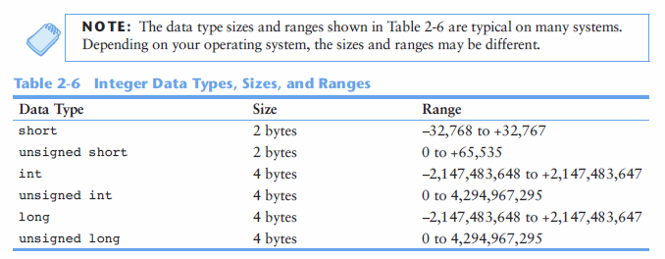
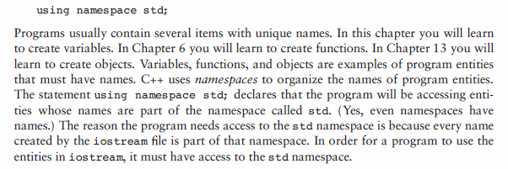
Namespaces allow to group entities like classes, objects and functions under a name. This way the global scope can be divided in "sub-scopes", each one with its own name.

Slide 15
#include "stdafx.h"
#include <iostream>
#include <string>
using namespace std;
int exit();
class Car
{
private:
int Year;
string Make;
int Speed;
public:
Car(int, string, int);
int getYear();
string getMake();
int getSpeed();
int Accelerate();
void getDisplay();
int Brake();
};
Car::Car(int Yr = 0, string Mk = " ", int Spd = 0) {
Year = Yr;
Make = Mk;
Speed = Spd;
}
int Car::getYear()
{
cout << "Enter the year of the car: ";
cin >> Year;
return Year;
}
string Car::getMake()
{
cout << "Enter the make and model of the car: ";
cin >> Make;
return Make;
}
int Car::getSpeed()
{
cout << "Enter the speed of the car: ";
cin >> Speed;
return Speed;
}
int Car::Accelerate()
{
Speed = Speed + 5;
return Speed;
}
int Car::Brake()
{
Speed = Speed - 5;
return Speed;
}
void Car::getDisplay()
{
int choice;
cout << "The car is a " << getYear() << " " << getMake() << " going " << getSpeed() << " MPH." << endl;
Car car(getYear(), getMake(), getSpeed());
do
{
cout << " Menu " << endl;
cout << "-----------------------" << endl;
cout << " 1. Accelerate " << endl;
cout << " 2. Brake " << endl;
cout << " 3. Exit " << endl;
cout << "-----------------------" << endl;
cout << "\nEnter your choice: " << endl;
cin >> choice;
switch (choice)
{
case 1: cout << "Accelerating";
cout << car.Accelerate();
break;
case 2: cout << "Braking";
cout << car.Brake();
break;
case 3: cout << "Exiting Program";
exit();
break;
}
while (choice < 1 || choice > 3)
{
cout << "\nYour choice must be 1-3. Re-enter.\n" << endl;
cout << " Menu " << endl;
cout << "-----------------------" << endl;
cout << " 1. Accelerate " << endl;
cout << " 2. Brake " << endl;
cout << " 3. Exit " << endl;
cout << "-----------------------" << endl;
cout << "\nEnter your choice: " << endl;
cin >> choice;
}
} while (choice != 3);
}
int exit()
{
return (0);
}
int main()
{
getDisplay();
cout << endl << "Press ENTER to exit...";
cin.clear();
cin.sync();
cin.get();
return 0;
}
int Car::Accelerate()
{
Speed = Speed + 5;
return Speed;
}
int Car::Brake()
{
Speed = Speed - 5;
return Speed;
}
void Car::getDisplay()
{
int choice;
cout << "The car is a " << getYear() << " " << getMake() << " going " << getSpeed() << " MPH." << endl;
Car car(getYear(), getMake(), getSpeed());
do
{
cout << " Menu " << endl;
cout << "-----------------------" << endl;
cout << " 1. Accelerate " << endl;
cout << " 2. Brake " << endl;
cout << " 3. Exit " << endl;
cout << "-----------------------" << endl;
cout << "\nEnter your choice: " << endl;
cin >> choice;

Slide 16
switch (choice)
{
case 1: cout << "Accelerating";
cout << car.Accelerate();
break;
case 2: cout << "Braking";
cout << car.Brake();
break;
case 3: cout << "Exiting Program";
exit();
break;
while (choice < 1 || choice > 3)
{
cout << "\nYour choice must be 1-3. Re-enter.\n" << endl;
cout << " Menu " << endl;
cout << "-----------------------" << endl;
cout << " 1. Accelerate " << endl;
cout << " 2. Brake " << endl;
cout << " 3. Exit " << endl;
cout << "-----------------------" << endl;
cout << "\nEnter your choice: " << endl;
cin >> choice;
}
} while (choice != 3);
}
int exit()
{
return (0);
}
int main()
{
getDisplay();
cout << endl << "Press ENTER to exit...";
cin.clear();
cin.sync();
cin.get();
return 0;
}

Slide 17
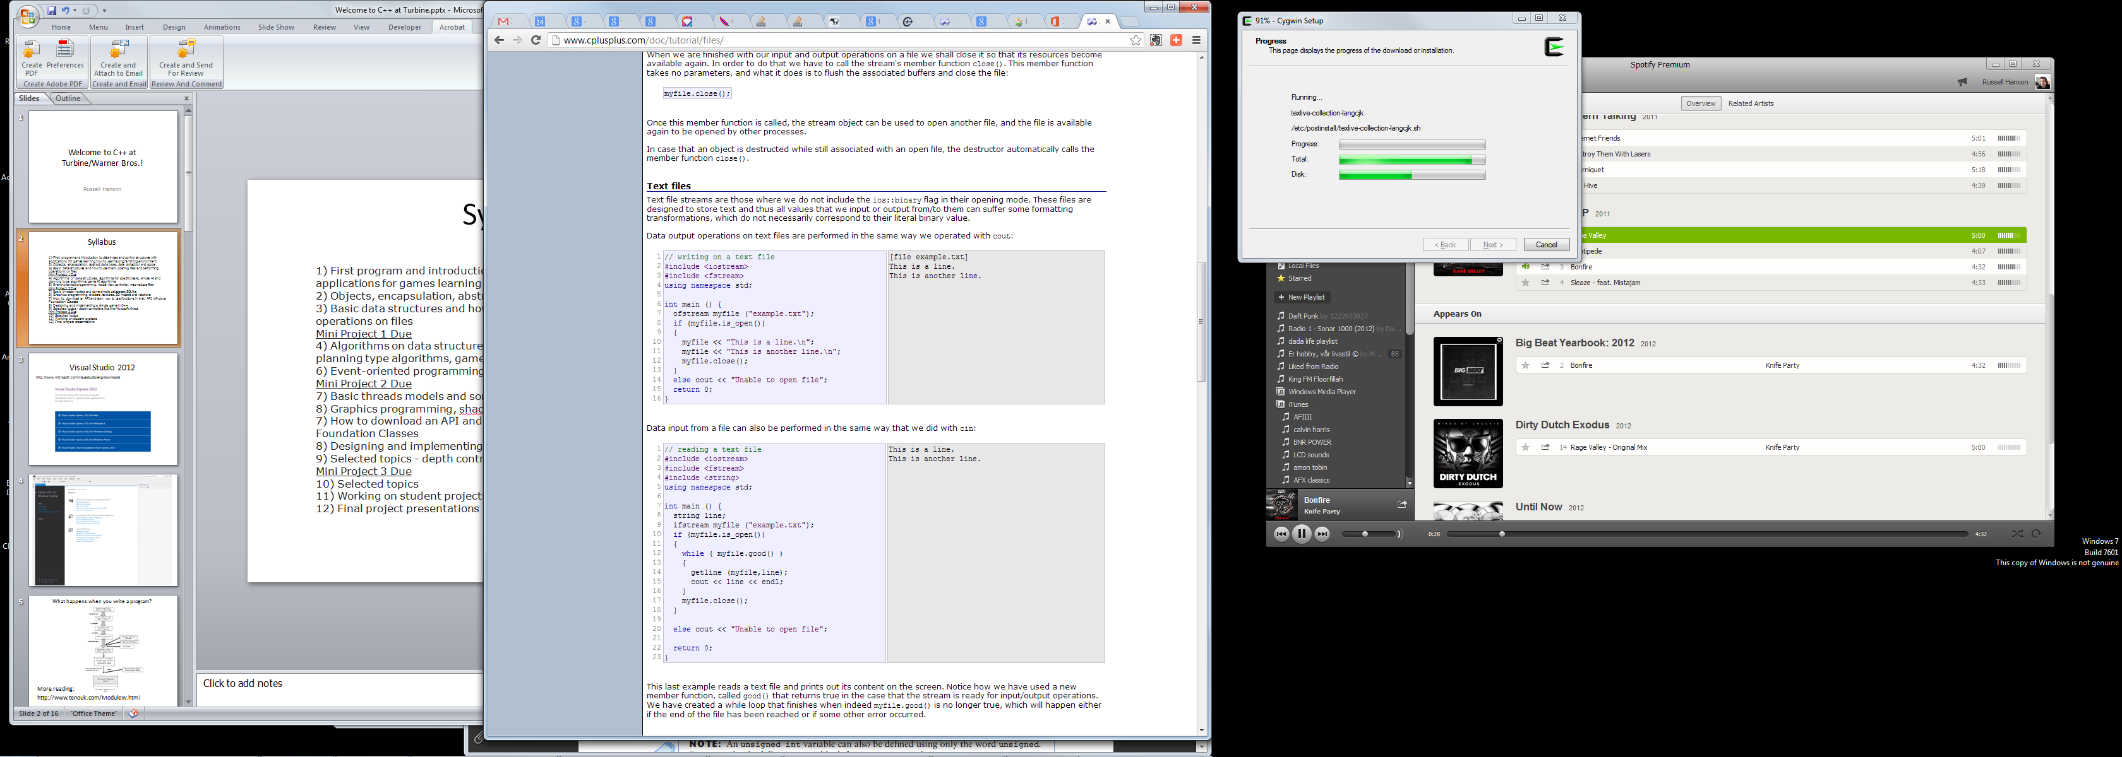
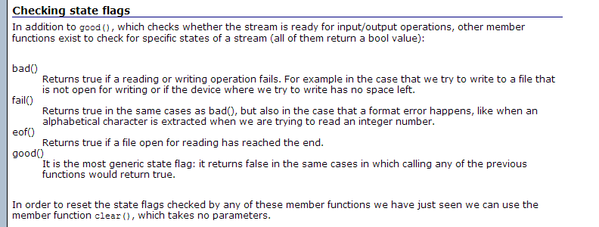
Reading from binary and text files
More at: http://www.cplusplus.com/doc/tutorial/files/

Slide 19
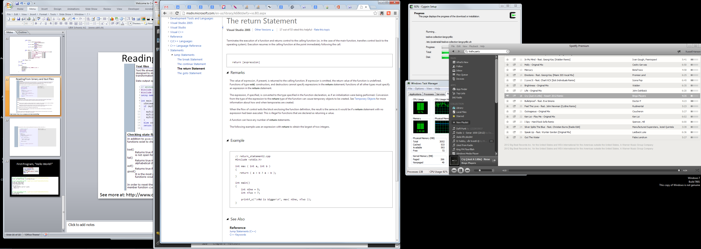
Return statement and functions

Slide 21
Control Structures
Conditional structures
Iteration structures
Jump statements
Selective structure

Slide 22
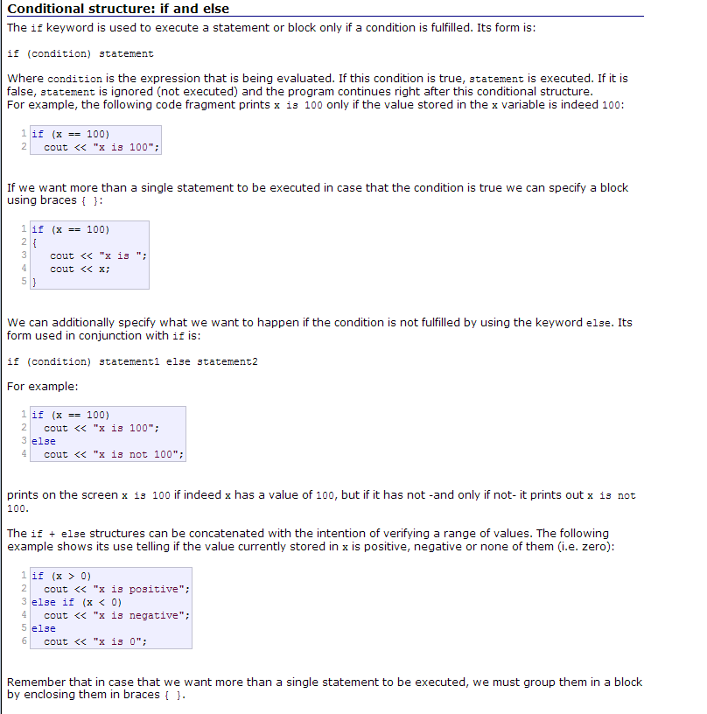
Control Structures

Slide 23
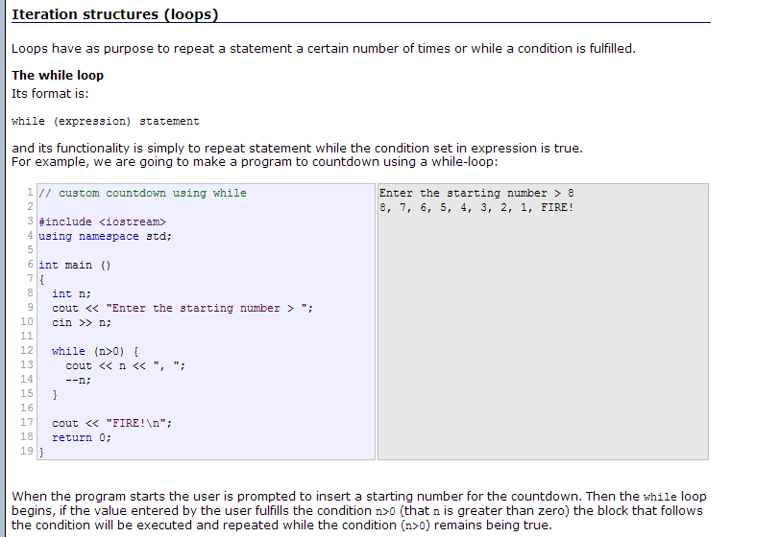

Slide 24
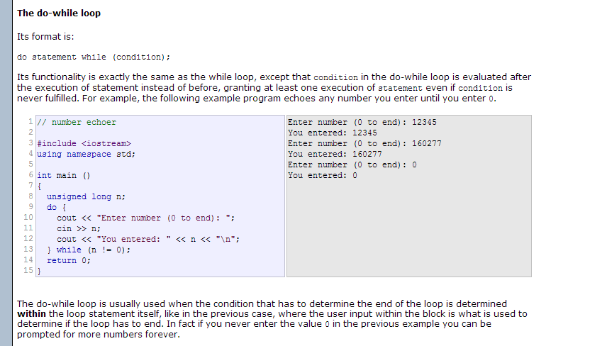

Slide 25
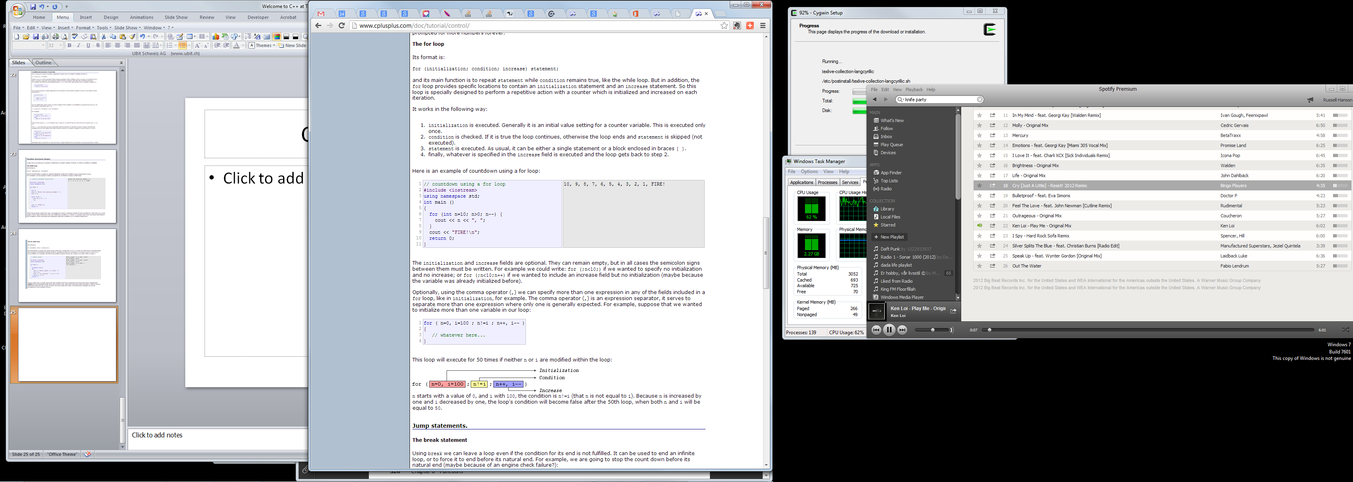

Slide 27
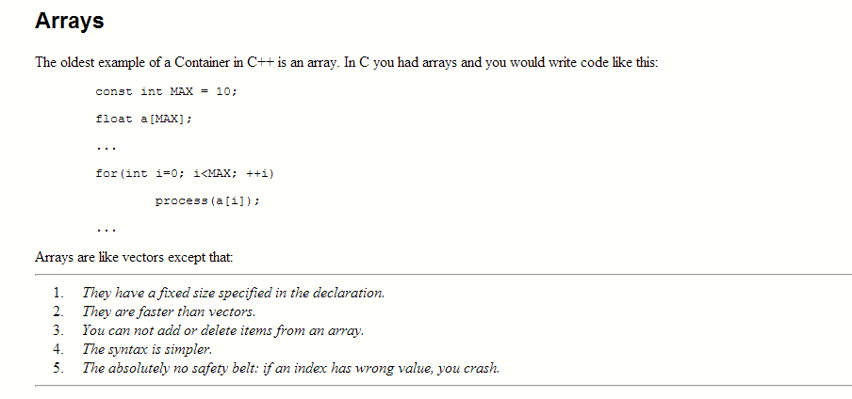
Arrays, Vectors, and Lists
C++ Array Size: The Size of an Array in C++
Short answer: use sizeof(array)/sizeof(element type).
For example: sizeof(scores)/sizeof(int), where scores is an array of ints.
This does not work with pointers.

Slide 28
#include <iostream>
using namespace std;
int main(int argc, char *argv[])
{
// Multidimensional array of numbers.
// We need to specify sizes for
// all except the first dimension.
int numbers[][3] =
{
{0, 1, 2},
{3, 4, 5}
};
for(int row=0; row < 2; row++){
for(int col=0; col < 3; col++){
cout << numbers[row][col] << endl;
}
}
}
OUTPUT:
0
1
2
3
4
5
#include <string>
#include <algorithm>
#include <iostream>
using namespace std;
bool sort_strings(const string& a, const string& b)
{
return a < b;
}
int main(int argc, char *argv[])
{
// Declare and initialize an array of strings.
string strings[] = {
"Fox",
"Beetroot",
"Zebra",
"Aardvark",
"Cabbage"
};
// Sort the array with STL sort.
sort(strings, strings + 5, sort_strings);
for(int i=0; i < sizeof(strings)/sizeof(string); i++)
{
cout << strings[i] << endl;
}
}
OUTPUT:
Aardvark
Beetroot
Cabbage
Fox
Zebra

Slide 29
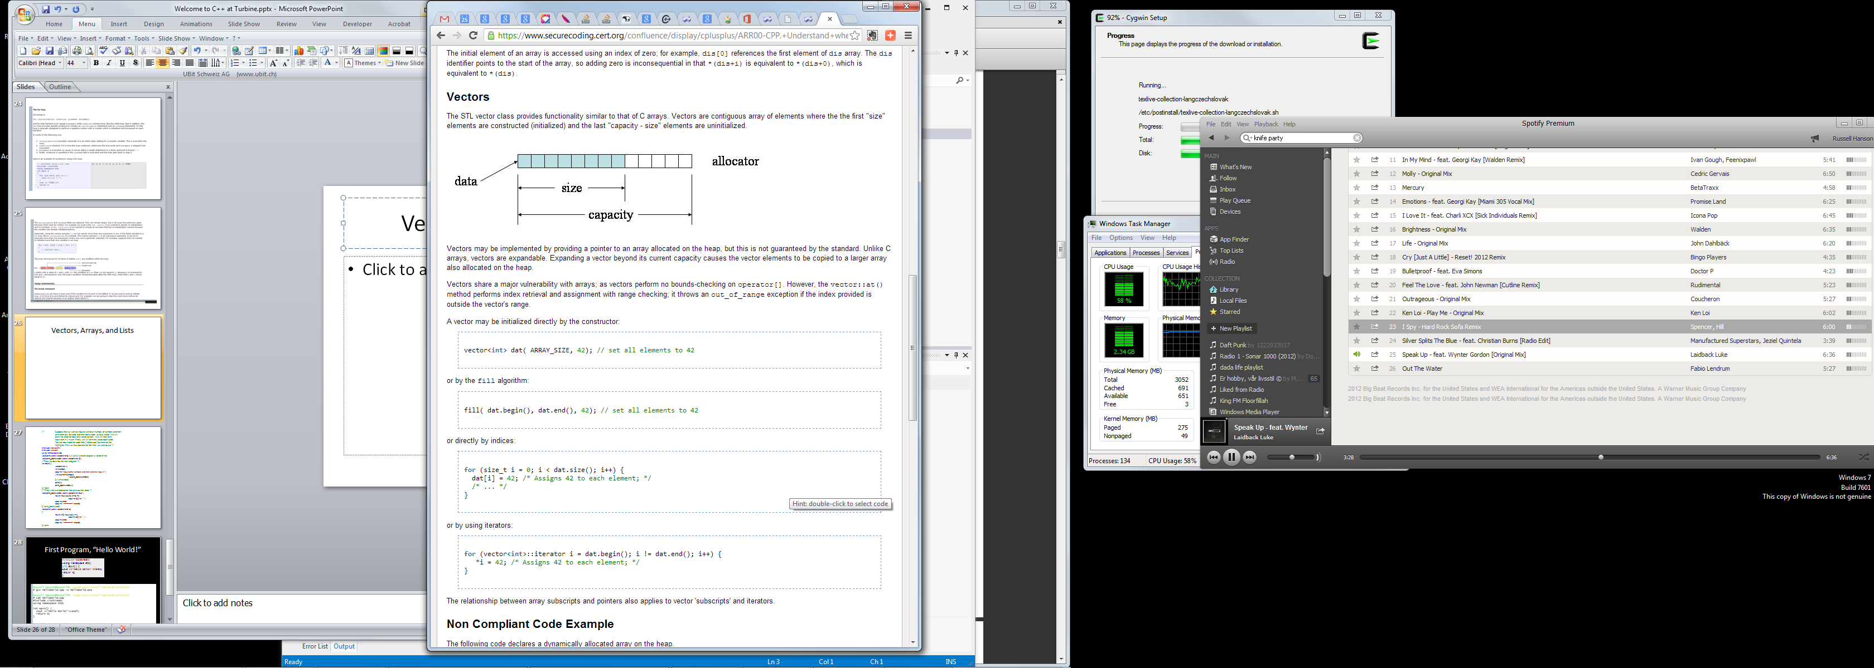
Arrays, Vectors, and Lists

Slide 31
/* Suppose that we want to input an unknown number of numbers and then
print them out forwards and then backwards, using a vector. We will
push ints onto the back of a vector called v. We will then print
each item in v in turn. Finally we will print the vector backwards.
You can download the code from [ Vector.cpp ] but here are the
highlights. First we must declare the facilities we want to use */
#include <iostream>
#include <vector>
using namespace std;
void print( const vector<int>& ) ;//utility function outputs a vector of ints
void print_backwards( const vector<int> &);
/*Then we describe the main program: */
int main() {
vector<int> v;
int number;
cout <<"Input some numbers and then end the input\n";
while(cin>>number){
v.push_back(number);
}//while(more)
print(v);
print_backwards(v);
}//main
/* Finally the two procedures that print out the data: */
void print_backwards( const vector<int> &a) {
for(int i=a.size()-1; i>=0; --i)
cout << a[i] << " ";
cout << endl;
cout << "----------------"<<endl;
}//print_backwards
void print( const vector<int>& a)
{
for(int i=0; i<a.size(); ++i)
cout << a[i] << " ";
cout << endl;
cout << "----------------"<<endl;
}//print

Slide 32
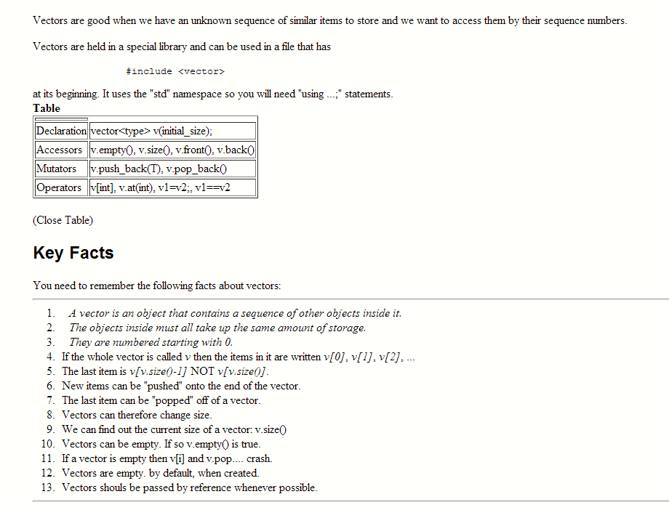

Slide 33
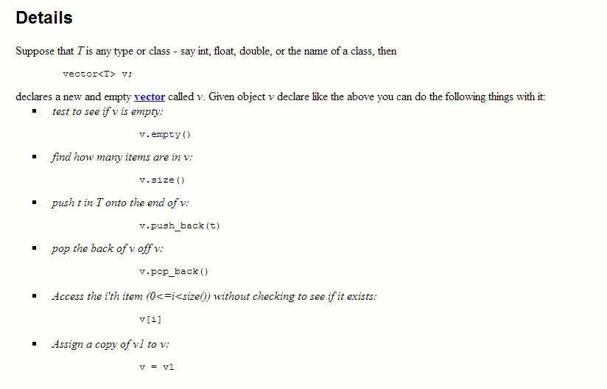

Slide 34
List
// constructing lists
#include <iostream>
#include <list>
int main ()
{
// constructors used in the same order as described above:
std::list<int> first; // empty list of ints
std::list<int> second (4,100); // four ints with value 100
std::list<int> third (second.begin(),second.end()); // iterating through second
std::list<int> fourth (third); // a copy of third
// the iterator constructor can also be used to construct from arrays:
int myints[] = {16,2,77,29};
std::list<int> fifth (myints, myints + sizeof(myints) / sizeof(int) );
std::cout << "The contents of fifth are: ";
for (std::list<int>::iterator it = fifth.begin(); it != fifth.end(); it++)
std::cout << *it << ' ';
std::cout << '\n';
return 0;
}

Slide 35
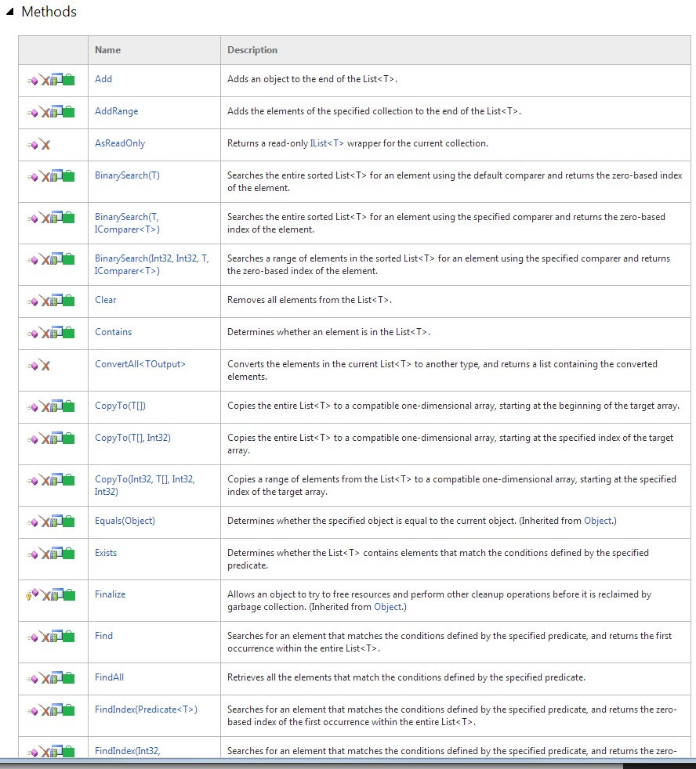
Using the MSDN to find the methods of class list: List<T> Class
(http://msdn.microsoft.com/en-us/library/6sh2ey19.aspx)
Represents a strongly typed list of objects that can be accessed by index. Provides methods to search, sort, and manipulate lists.

Slide 36
First Program, “Hello World!”
#include <iostream>
using namespace std;
int main() {
cout <<"Hello World!"<<endl;
return 0;
}

